Slide 1

DBMS
Lecturer
Rokas Slaboševičius
Data

Slide 2
Today you will learn
DBMS
What are joins and what are they?
01
What are sub-queries?
02

Slide 3
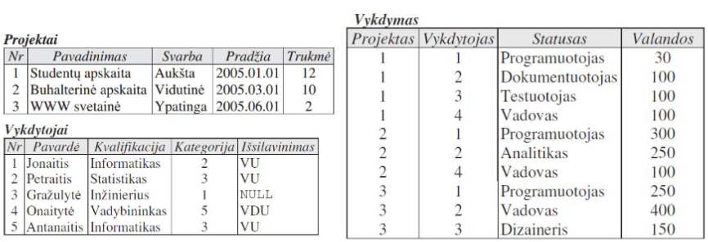
Data retrieval (SQL JOIN statement)
DBMS
One of the most important features of a SELECT statement is the ability to join two or more tables.

Slide 4
Joining multiple tables
DBMS
A query joining 2 tables looks like this:
SELECT <columns> FROM <table1>, <table2> WHERE <join condition> [AND <search condition>];
In many DBMS tables, the join is achieved by the SELECT statement JOIN:
SELECT <columns> FROM <table1> JOIN <table2> ON <join condition> [WHERE <search condition>];

Slide 5
Joining multiple tables
DBMS
Names of promoters of project No 1:
SELECT "Surname" FROM "Executors", "Execution" WHERE "Executor" = "No" AND "Project" = 1;
Condition "Executor" = "No" - logical link between two tables.
In the general case, if the query does not have any condition for two tables and one of the tables has n rows and the other has m rows, the result will be m × n rows

Slide 6
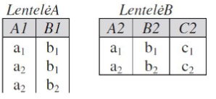
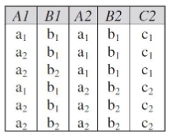
Joining multiple tables
DBMS
SELECT A1, B1, A2, B2, C2 FROM TableA, TableB;
Result:

Slide 7
Joining multiple tables
DBMS
Location:
SELECT A1, B1, A2, B2, C2 FROM TableA, TableB;
you can write:
SELECT * FROM TableA, TableB;

Slide 8
Joining multiple tables
DBMS
Information on which promoters are running which projects and how many hours are spent on each project:
SELECT "Surname", "Name", "Hours"
FROM "Executors", "Projects", "Execution"
WHERE "Project" = "Projects". "No" AND "Contractor" = "Contractors". "No";
The adjustment of the column "No" in the name of the table is necessary because both tables have a column named "No".

Slide 9
Joining multiple tables
DBMS
SELECT "A". "Surname", "B". "Surname" FROM "Executors" "A", "Executors" "B" WHERE "A". "Qualification" = "B". "Qualification" AND "A". "No" < "B". "No"
We consider that there are two copies of one table. We define synonyms for the tables: 'A' and 'B'.'A'.'Qualification' = 'B'.'Qualification' - a join condition.'A'.'No' < 'B'.'No' - avoids duplication of the pair of the principal with itself and of the pairs, i.e., instead of the 2 pairs (x, y) and (y, x) it is sufficient to have 1.
DISTINCT is not appropriate in this case because (x, y) is not equal to (y, x) if only x is not equal to y.

Slide 10
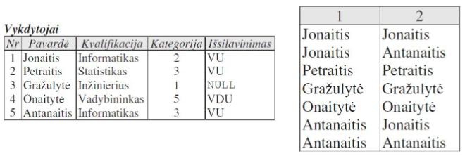
Joining multiple tables
DBMS
SELECT DISTINCT "A". "Surname", "B". "Surname" FROM "Executors" "A", "Executors" "B" WHERE "A". "Qualification" = "B". "Qualification";

Slide 11
Joining multiple tables
DBMS
SELECT "A". "Surname", "B". "Surname"
FROM "Executors" "A", "Executors" "B"
WHERE "A". "Qualification" = "B". "Qualification"
AND "A". "No" <> "B". "No";

Slide 12
Joining multiple tables
DBMS
Executors working on critical projects and how many hours they devote to each project:
SELECT "Surname", "Name", "Hours"
FROM "Executors", "Projects", "Execution"
WHERE "Project" = "Projects". "No"
AND "Executor" = "Executors". "No"
AND 'Importance' = 'Special';

Slide 13
Joining multiple tables
DBMS
The names of all promoters:
SELECT "Surname" FROM "Executors"; - the most correct query;
SELECT "Surname" FROM "Executors", "Projects"; - repeated as many times as there are projects;
SELECT DISTINCT "Surname" FROM "Executors", "Projects"; - correct, but ineffective;

Slide 14
Joining multiple tables with JOIN
DBMS
Names of the promoters of Project 1:
SELECT "Surname" FROM "Executors "JOIN "Execution" ON "Executor" = "No" WHERE "Project" = 1;
Query without JOIN:
SELECT "Surname" FROM "Executors", "Execution" WHERE "Executor" = "No" AND "Project" = 1;

Slide 15
Joining multiple tables with JOIN
DBMS
You can join more tables, for example:
SELECT "Surname", "Title", "Hours" FROM("Executors" JOIN "Execution" ON "Executor" = "Executors". "No")JOIN "Projects" ON "Project" = "Projects". "No";
Query without JOIN:
SELECT "Surname", "Title", "Hours" FROM "Executors", "Projects", "Execution" WHERE "Project" = "Projects". "No" AND "Executor" = "Executors". "No";

Slide 16
Joining multiple tables with JOIN
DBMS
Names, statuses and hours of all project 1 promoters:
SELECT "Last Name", "Status", "Hours "FROM "Executors" JOIN "Execution" ON "Executor" = "No" WHERE "Project" = 1;
The result will only contain the names of the authors involved in project 1, there will be no implementer 5. Executor 5 is not involved in any project - he is not in the "Execution" table.Executors are given by outer merging.

Slide 17
Joining multiple tables with JOIN
DBMS
LEFT JOIN - the result of the join is appended to the non-joinable rows of the left (first) table.
RIGHT JOIN - the result of the join is appended to the non-joinable rows of the right (second) table.
FULL JOIN - appends rows from both tables with non-joinable rows.
The JOIN operation is identical to the INNER JOIN operation.

Slide 18

Joining multiple tables with JOIN
DBMS

Slide 19
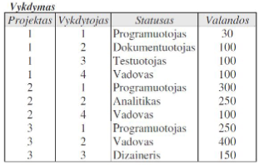
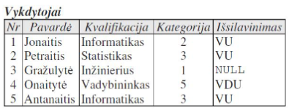
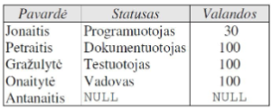
Joining multiple tables with JOIN
DBMS
Staff and their participation in the project 1:
SELECT "Last Name", "Status", "Hours "FROM "Executors" LEFT OUTER JOIN "Execution" ON "No" = "Executor" WHERE "Project" = 1;

Slide 20
Joining multiple tables with JOIN
DBMS
One query can contain another query, i.e. possible structured queries - "Structured QL". Multiple SELECT statements are in a strict hierarchical dependency.
Names of promoters involved in the project No 1:
SELECT "Surname" FROM "Executors" WHERE "No" IN(SELECT "Executor" FROM "Execution" WHERE "Project" = 1);

Slide 21
Joining multiple tables with JOIN
DBMS
Contractors involved in at least one project of major importance:
SELECT "Surname" FROM "Executors" WHERE "No" IN
(SELECT "Executor" FROM "Execution" WHERE "Project" IN
(SELECT 'No' FROM 'Projects' WHERE 'Importance' = 'Special'));

Slide 22

DBMS
Task 1
1.Select the names of the staff members together with the name of the project they work on.
2.Select the names of the staff working on the project in Kaunas and the name of the project.
3.Select all the Registry Centre project implementers working in the Testing Department.
4.Select all the women working in the Izola project and display their names and the name of the project.
5.Select the names of the departments with the number of employees working in them.
6.Restrict the result of query #5 to show only departments with at least 5 employees.
7.Please select the names of the staff members, together with the names of the departments in which they work, but who are not the heads of those departments.
8.Create a new record in the table "EMPLOYEE" (personal code: 38807117896, first name: Pranas, last name:Logis, Employed since: 2009-11-12, year of birth: 1988-11-14, title: null, department_name: null, project_id: null).

Slide 23
DBMS
Task 2
9.Select the names of the staff and the name of the department. Show even staff who do not work in any department (take the department name from the DEPARTMENT table).
10.Please modify the query in point 1# to show only names and project names with more than 4 employees.
11. Select all developers working on the Accounting project
12. Please select the projects that have promoters without a degree
13. List the names and qualifications of the people working on the Medium Priority Project
14. Please select the names of the promoters working on projects prior to 01.05.2005
15. Please select the projects that have VU-educated implementers

Slide 24
Lecture title
Headline
www.youtube.com
Useful information

